Slide 1
Chapter 6: Root Position Composition (Part-Writing)
MUS 112 – Molloy College

Slide 2
Introduction
Up to this point in the semester we have been primarily focused on the elements of music
Meter
Rhythm
Pitch
Harmony
From here on out, we will primarily be focused on combining these elements into music (i.e. composing)
Not just writing individual chords and melodies, but combining it all together
We will continue to focus on and develop writing music utilizing tonal (functional) harmony.

Slide 3
Composition (Part-Writing)
We will be doing a lot of 4-part chorale writing to develop and reinforce a mastery of tonal harmony.
I strongly encourage you to think of this as composing for a quartet of musicians.
To that end, we will be performing examples in each class.
There will be two groups. A Monday group, and a Wednesday group.
You will bring your instrument or sing.

Slide 4
Root Position Composition
Now that we know all of our diatonic chords in all keys every inversion, we can begin to connect chords together in a meaningful way
We will begin by focusing on only triads. We will compose with seventh chords later in the semester.
You are still responsible for recognizing seventh chords in analysis
We will also limit our triads to root position so we can master how each part individually moves to help create a specific harmony.

Slide 5
Doubling in Root Position Chords
When writing a triad in 4 voices:
All members of the triad are present. (usually)
Double the root. (usually)
But do not double ^7.
So if you have viiº, double the third of the chord.
Incomplete chords are also possible.
This is a chord that omits the 5th

Slide 6
Root-movement
Root-movement: the interval by which the root moves when switching harmonies.
I – V has a root-movement of what?
By a fifth
Which is equal to by a fourth, why?
What are the different types of root movement?
Stay the same
2nd (equal to 7th)
3rd (equal to 6th)
4th (equal to 5th)
Now let’s look at the smoothest way to compose these various root movements.

Slide 7
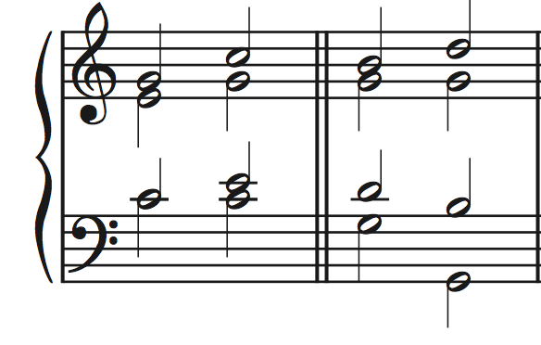
Repeated Root
The root stays the same between two chords
(Which means the chords stays the same!) Why?
Because both chords are in root-position
Basically, anything goes!
The upper voices may be arpeggiated freely, as long as the spacing conventions are followed.
The bass may also jump by an octave
When the root is repeated, it is a great opportunity to re-voice the chord

Slide 8
Root movement by 4th (5th)
Root movement by a fourth or fifth describes the most important harmonic progression in tonal music.
V to I
We are going to develop some strategies to help us compose root-movement of a 4th or 5th and avoid objectionable parallels.
KEEP THE COMMON-TONE!
Whenever possible, keeping the common-tone helps to create very smooth part-writing.
If you can’t keep the Common Tone move step-wise.
When you have root-movement by a 4th, one of the three upper voices will stay the same, and the other two will move by step.

Slide 9
Transposing Instruments
On Transposing Instruments notes do not sound at the same pitch as they are written.
Written pitch = the note on the page
Concert pitch = the note sounding
Transposing Instruments present at many different transposition level.
D, Eb, F, G, A, Bb, octave, etc.
A transposing instrument will often indicate what key the instrument is in:
Horn in F
Trumpet in Bb
Eb Baritone Saxophone
The key of the instrument tells us what note sounds when a C is written
For example, on Bb Trumpet, when a C is written a Bb is the sounding pitch

Slide 10
Appendix A

Slide 11
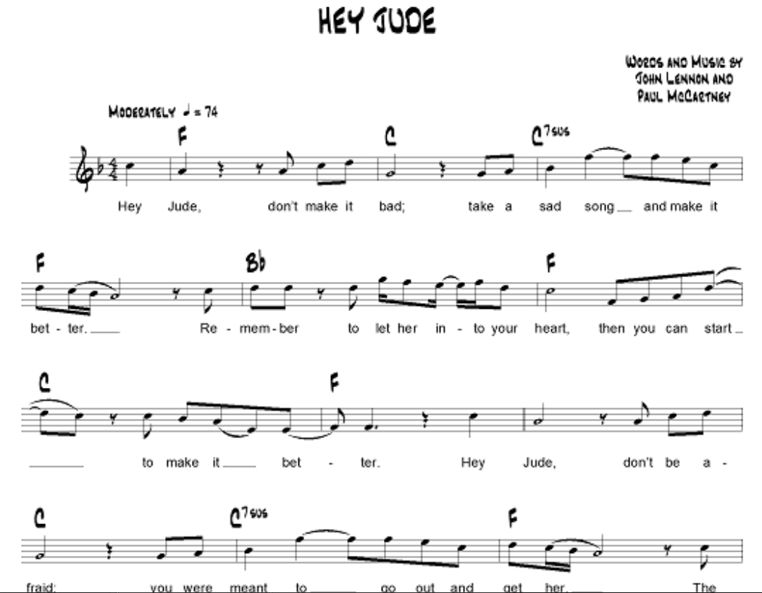
Bb

Slide 12
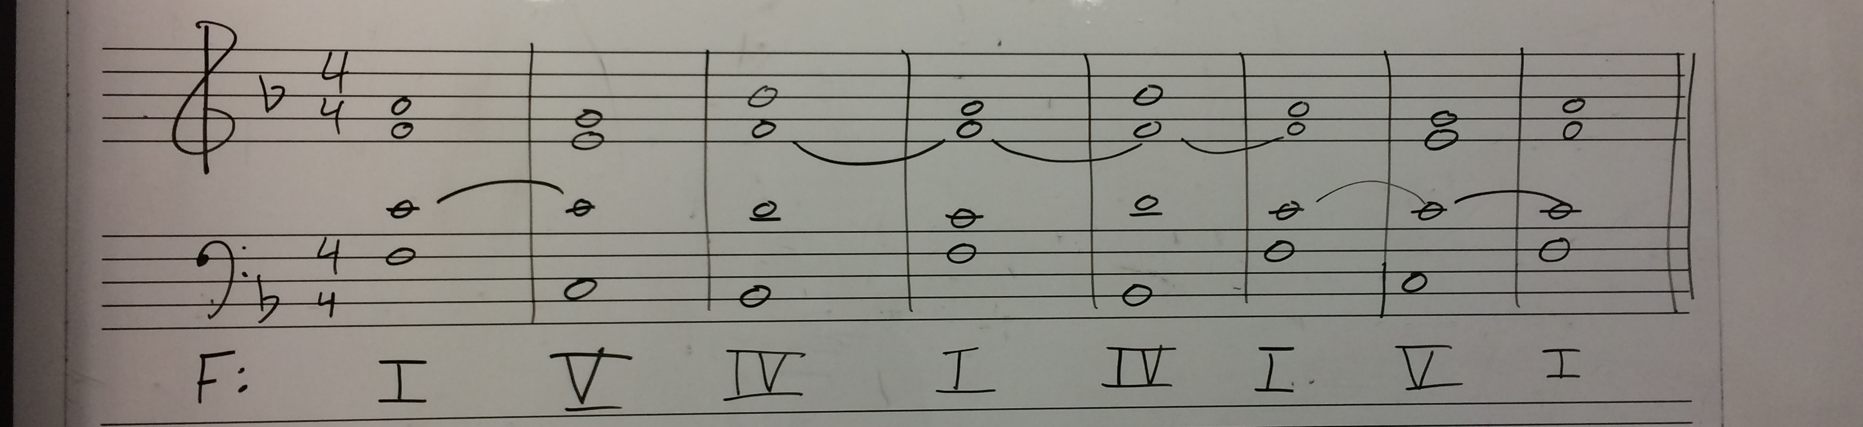
“Hey Jude” Chorale

Slide 13
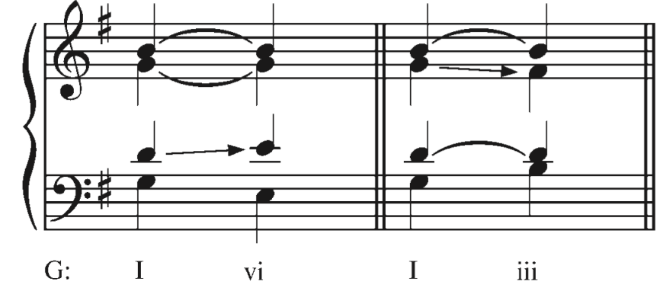
Composing with Roots a 3rd (6th) Apart
The voice leading that involves root position triads a 3rd or 6th apart is usually quite smooth because the two triads will always have two pitch classes in common.
Two common tones and stepwise.

Slide 14
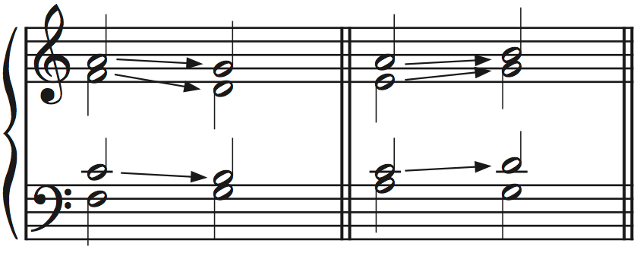
Composing with Roots a 2nd (7th ) Apart
When the root is doubled, which it normally should be:
Move in contrary to the bass to the nearest chord tone.

